Slide 1

PCWG 2016 Roadmap & Meeting Overview
Thursday, September 29 2016
PCWG, Minneapolis
Jason Fields (NREL)

Slide 2
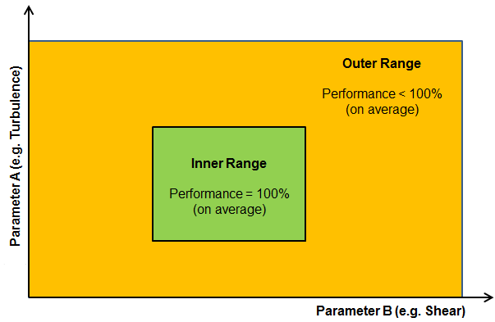
Reflecting the Real World…
Categories of Turbine Performance Corrections
Inner Range Performance
Adjustments to reflect the fact that even under warranted/ideal conditions performance may not be 100%
Outer Range
Outer Range Performance
Adjustments to reflect the fact that turbine performance may deviate from Inner Range behaviour in Outer Range Conditions
e.g. Low/High TI, Low/High Shear etc.
Inner Range
+ Other Performance Corrections
Icing, Blade Degradation, Sub-optimal performance etc.
Note: The PCWG Inner-Outer Range Proposal is Conceptual Decomposition, and does infer specific parameter ranges.

Slide 3

Reflecting the Real World: Inner Range Performance
Historic Performance Under Inner Range Conditions
The PCWG is seeking to design an adjustment framework to define how to make best use of historic power performance tests when predicting future turbine performance.
Extract from ‘High Resolution Turbine-Specific Matrix’, Carl Ostridge DNV GL,
Colorado PCWG Meeting, 10 August 2016, download from www.pcwg.org.

Slide 4
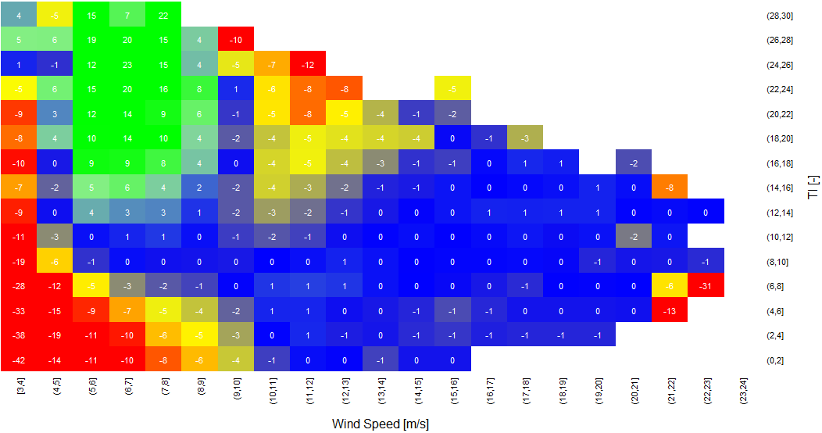
Reflecting the Real World: Outer Range Performance
Inner Range Performance
Outer Range Deviations (Observed – Base)
Colour = % Observed Power Deviation
(Observed - Base)
High TI & High V
Negative Deviation
High TI & Low V
Positive Deviation
Power (P)
P=P(v, ρ)
Turbulence Intensity [%]
Low TI & Low V
Negative Deviation
Wind Speed (v)
Wind Speed [m/s]
The PCWG is attempting to evaluate methods for predicting Outer Range performance via the PCWG Intelligence Sharing Initiative (PCWG-Share-X)

Slide 5
PCWG 2016 Roadmap

Slide 6
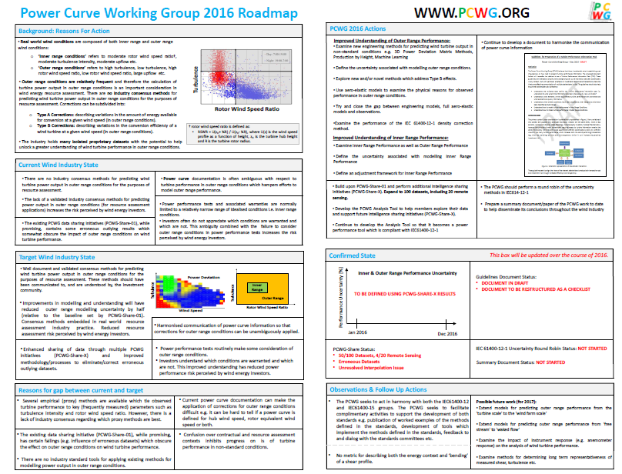

Slide 7
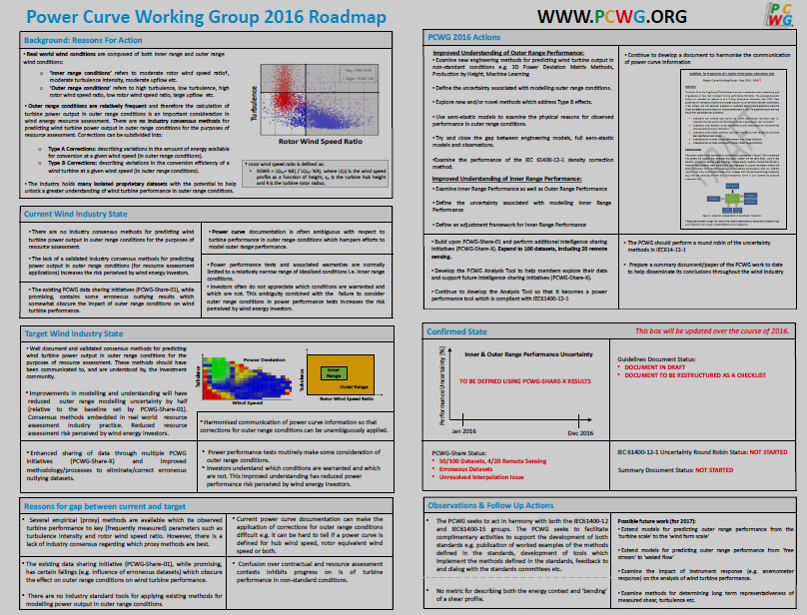
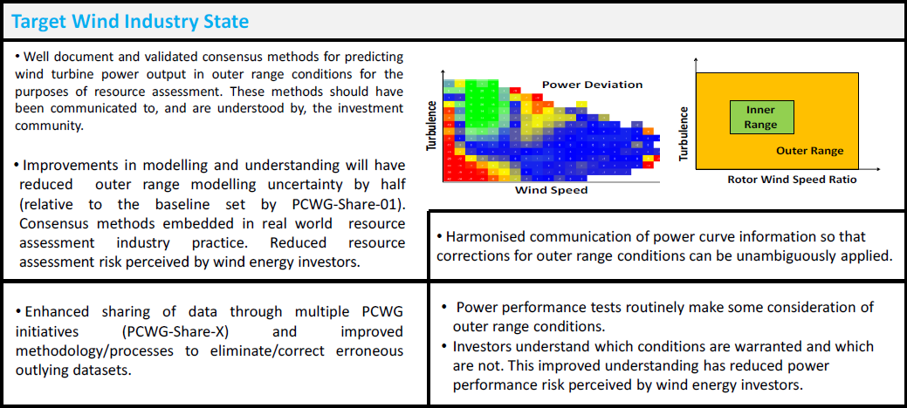

Slide 8
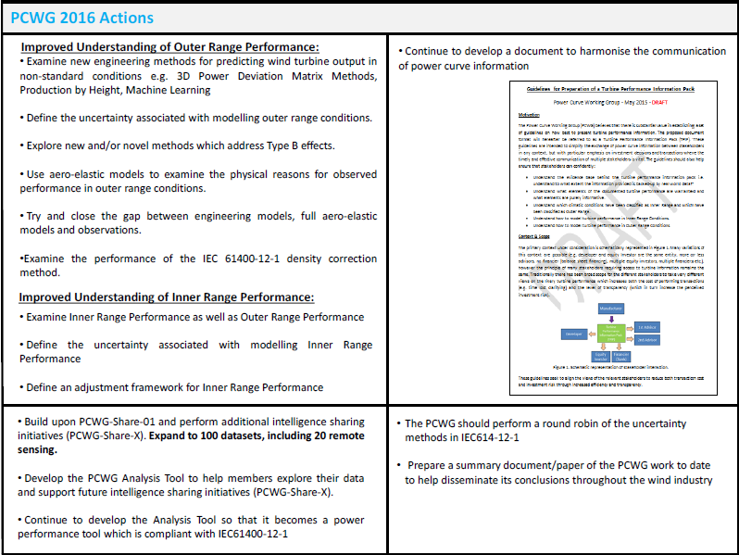
Priority Actions (what we are working on right now)
Note: as IEA Task 32 also planned a IEC61400-12 Round Robin the PCWG has focused on worked examples (more later).

Slide 9
Meeting Overview

Slide 10
Meeting Overview
Introduction (Erik Hale and Jason Fields)
PCWG-Share-X, Intelligence Sharing Initiative (Andy Clifton)
Preparing for 61400-12-1 Ed 2 (Ellie Weyer & Vineet Parkhe):
IEA Task 32 Round Robin
PCWG Worked Examples
Inner Range Performance (Erik Hale & Dan Bernadette)
Technical Presentations and Q&A (Yu Ding & Gil Lizcano)
Further Discussion (chaired by Jason Fields)

Slide 11
Join the Power Curve Working Group at: www.pcwg.org

